Slide 1

UWEBIC IY425
Electrical and Electronic Engineering Principles 2
INTRODUCTION TO ALTERNATING
CURRENT AND VOLTAGE
Thursday 20-Jan-2022

Slide 2
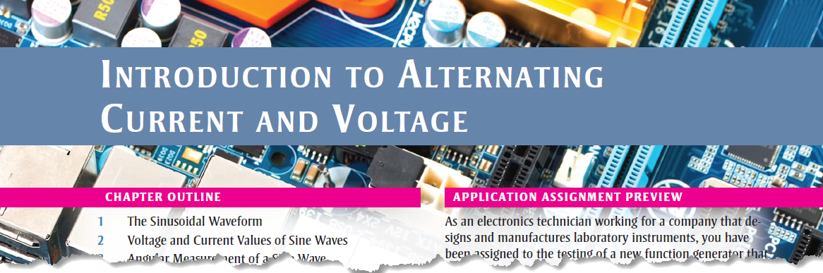
Today Reference
Chapter 8 of Electronics Fundamentals: Circuits, Devices, and Applications, Eighth Edition, Thomas L. Floyd, David M. Buchla.

Slide 3
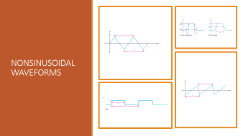
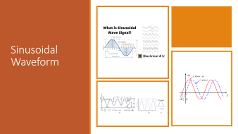
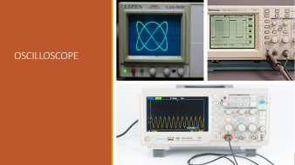
Today Topics

Slide 4
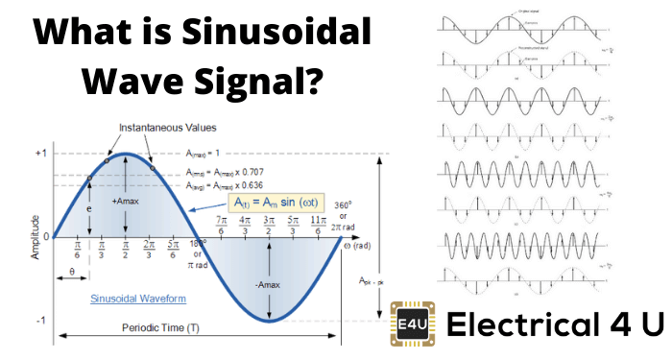
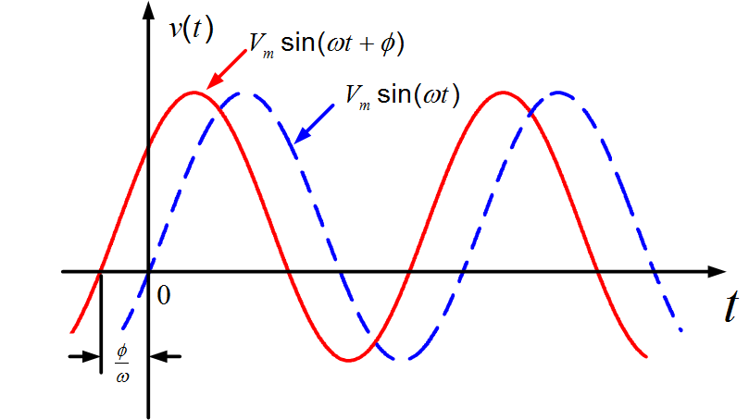
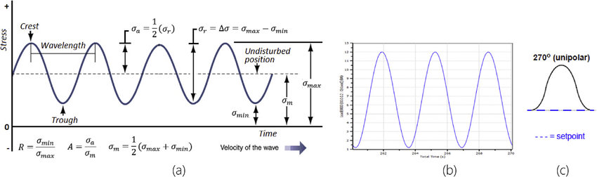
Sinusoidal Waveform

Slide 5
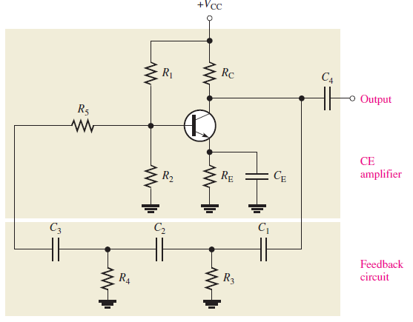
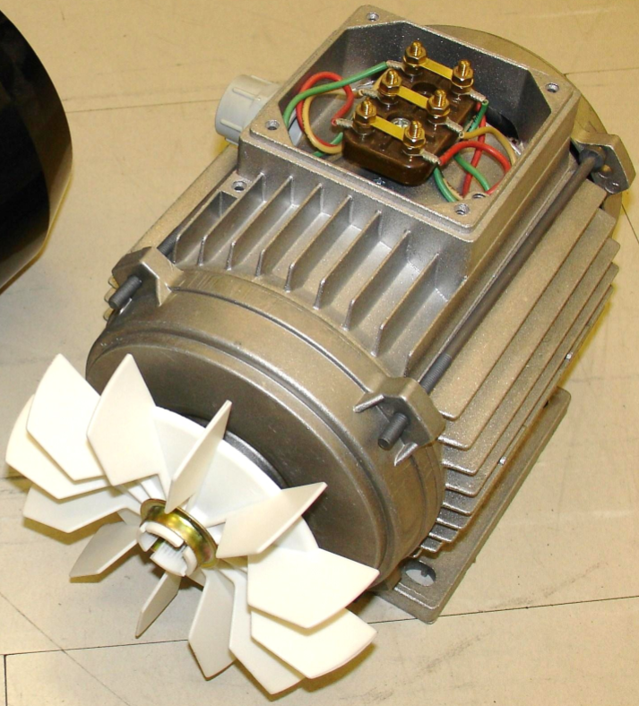
Sinusoidal Waveform
The sinusoidal waveform or sine wave is the fundamental type of alternating current (ac) and alternating voltage.
Sources of sine waves
Rotating electrical machines (ac generators)
Electronic oscillator circuits

Slide 6
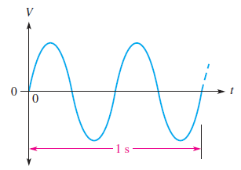
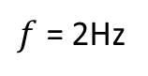
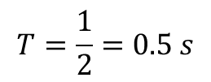
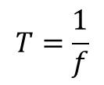

Period-Frequency
$f$ = 2Hz
$$T=\frac{1}{f}$$
$$T$$
$$T=\frac{1}{2}=0.5 s$$

Slide 7
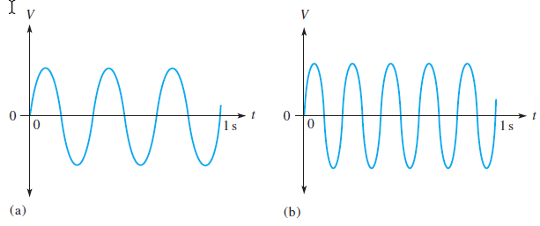
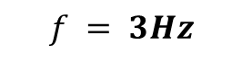
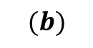
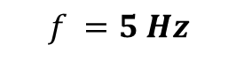
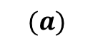
Which sine wave in this figure has the higher frequency? Determine the frequency and the period of both waveforms.
$$(a)$$
$$f = 3Hz$$
T = 0.333 s = 333 ms
$$(b)$$
$$f =5 Hz$$
T = 0.2 s = 200 ms

Slide 8
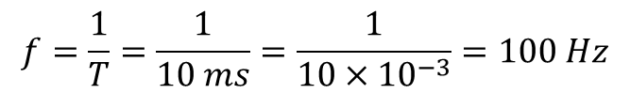
Quiz
The period of a certain sine wave is $10 ms$. What is the frequency?
$$f=\frac{1}{T}=\frac{1}{10 ms}=\frac{1}{10×{10}^{−3}}=100 Hz$$

Slide 9
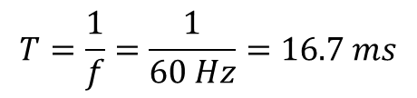
Quiz
The frequency of a sine wave is 60 Hz. What is the period?
$$T=\frac{1}{f}=\frac{1}{60 Hz}=16.7 ms$$

Slide 10
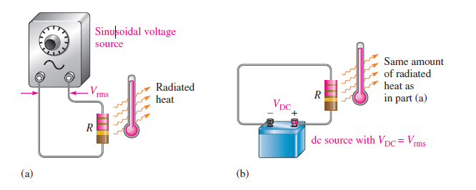
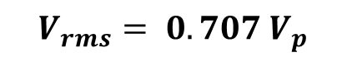
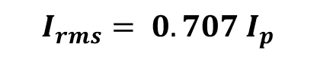
RMS Value
$$V_{rms}= 0.707 V_{p}$$
$$I_{rms}= 0.707 I_{p}$$

Slide 11
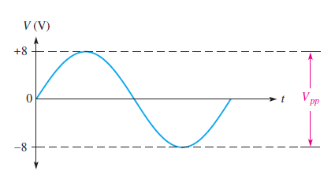
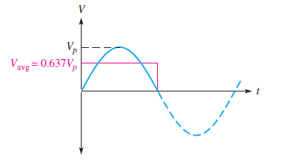
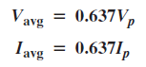
Average Value

Slide 12
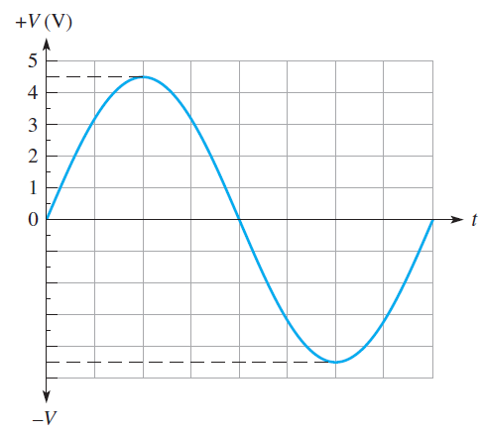
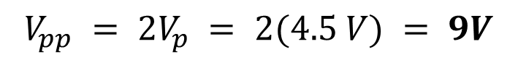

Quiz
Determine $V_{p}, V_{pp}, V_{rms},$and the half-cycle $V_{avg}$ for the sine wave in this figure.
$$V_{p} = 4.5 V$$
$$V_{pp} = 2V_{p} = 2(4.5 V) = 9V$$
$$V_{rms} = 0.707V_{p} = 0.707(4.5 V) = 3.18 V$$
$$V_{avg} = 0.637V_{p} = 0.637(4.5 V) = 2.87 V$$

Slide 13
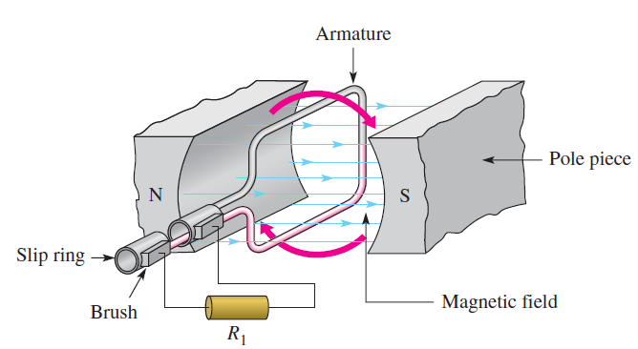
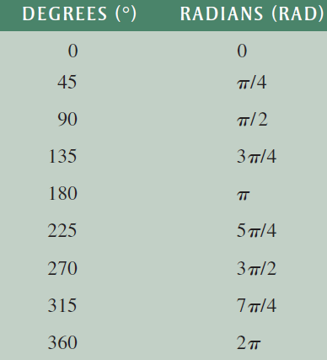






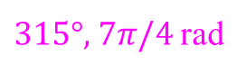
ANGULAR MEASUREMENT OF A SINE WAVE
$$90°, π/2 rad$$
$135°, 3π/4$rad
$45°, π/4$rad
$180°, π$ rad
0°, 0 rad
$225°, 5 π/4$rad
$\text{315}\text{°}\text{, 7}π/4$rad
$\text{270}\text{°}\text{, 3}π/2$rad

Slide 14
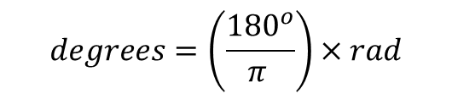


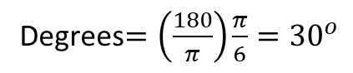
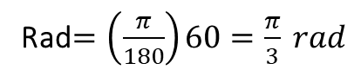

Radian/Degree Conversion
$$rad=\left(\frac{π }{{180}^{o}}\right)×degrees$$
Examples:
Convert ${60}^{0}$to radians.
Rad$=\left(\frac{π}{180}\right)60=\frac{π}{3} rad$
$$degrees=\left(\frac{{180}^{o}}{π }\right)×rad$$
Convert $\frac{π}{3}$ radian to degrees
Degrees$=\left(\frac{180}{π}\right)\frac{π}{6}={30}^{o}$

Slide 15
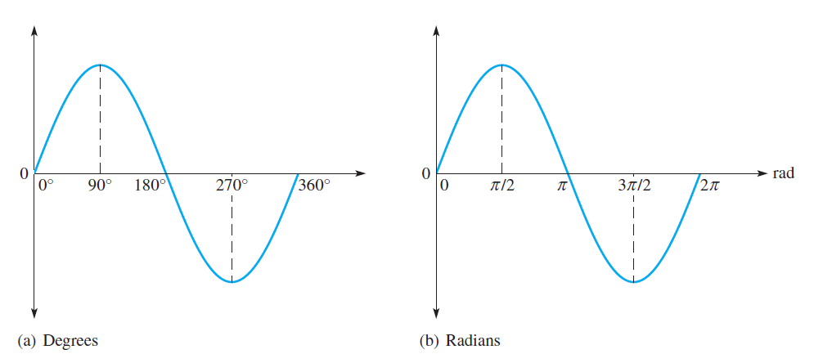
Sine Wave Angles

Slide 16
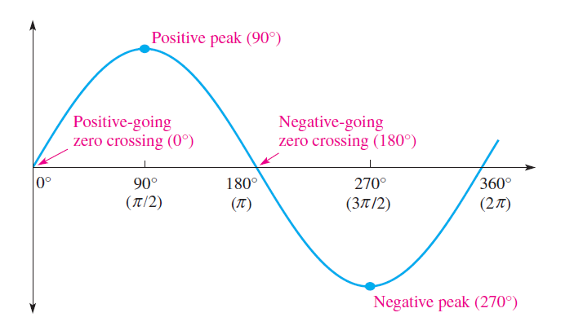
Phase of a Sine Wave

Slide 17
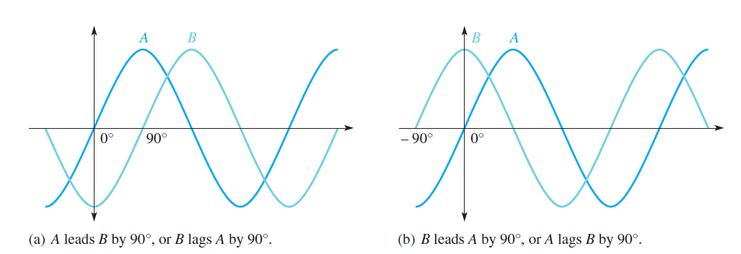
Phase of a Sine Wave

Slide 18
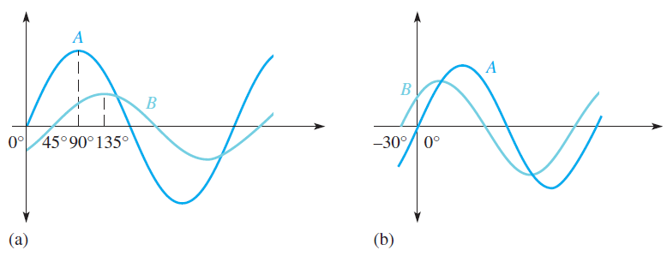
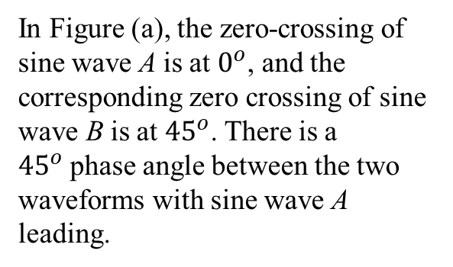
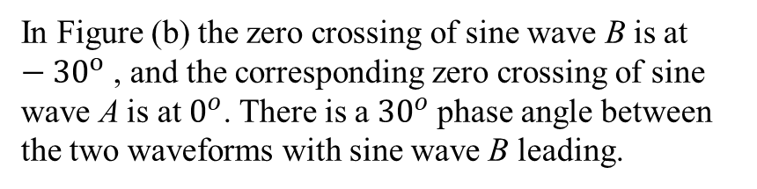
Quiz
What are the phase angles between sine waves A and B in Figures (a) and (b)?
In Figure (a), the zero-crossing of sine wave A is at $0^{o}$, and the corresponding zero crossing of sine wave B is at ${45}^{o}$. There is a ${45}^{o}$phase angle between the two waveforms with sine wave A leading.
In Figure (b) the zero crossing of sine wave B is at $−{30}^{o}$ , and the corresponding zero crossing of sine wave A is at $0^{o}$. There is a ${30}^{o}$phase angle between the two waveforms with sine wave B leading.

Slide 19
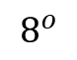
Quiz
If the positive-going zero crossing of one sine wave is at ${15}^{o}$relative to the $0^{o}$reference and that of the second sine wave is at ${23}^{o}$relative to the $0^{o}$reference, what is the phase angle between the sine waves?
Answer
$$8^{o}$$

Slide 20
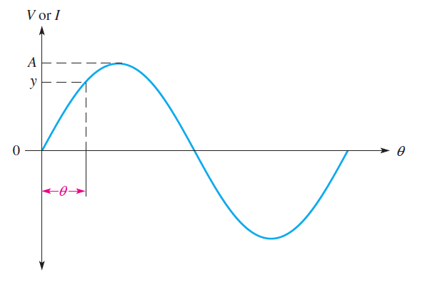
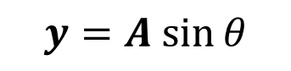
SINE WAVE FORMULA
$$y=A sin⁡θ$$

Slide 21
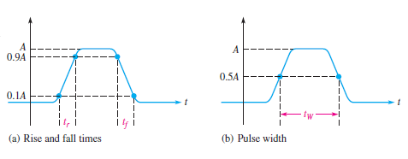
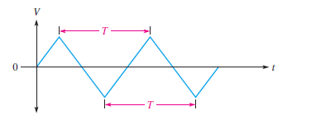
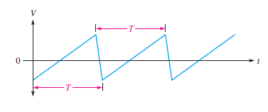
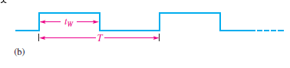
NONSINUSOIDAL WAVEFORMS

Slide 22
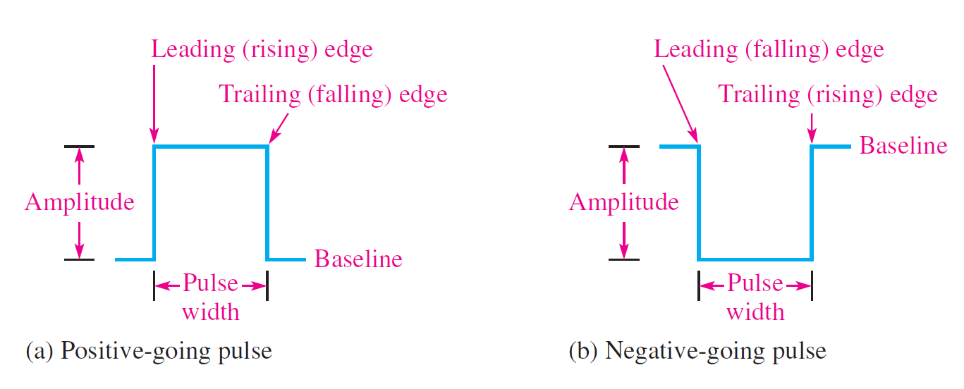
Pulse Waveforms
Basically, a pulse can be described as a very rapid transition.

Slide 23
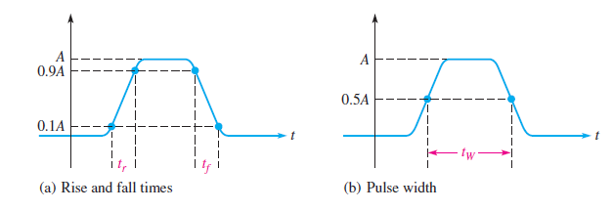
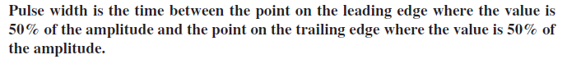
Pulse Waveforms

Slide 24


Repetitive Pulses
Any waveform that repeats itself at fixed intervals is periodic.
$$f=\frac{1}{T}$$

Slide 25

Duty Cycle

Slide 26


Exercise

Slide 27

Square Waves

Slide 28

Average Value of a Pulse Waveform

Slide 29


Slide 30




Slide 31



OSCILLOSCOPE

Slide 32
OSCILLOSCOPE
The oscilloscope, or (scope for short) is a widely used and versatile test instrument for observing and measuring waveforms.

Slide 33

OSCILLOSCOPE
Digital Oscilloscope
Analog Oscilloscope

Slide 34

OSCILLOSCOPE front panel view

Slide 35
Vertical Controls
The position control lets you move a displayed waveform up or down vertically on the screen.
The Volts/Div control adjusts
the number of volts represented by each vertical division on the screen.

Slide 36
Horizontal Controls
The Position control lets you move a displayed waveform left to right horizontally on the screen.
The Sec/Div control adjusts the time represented by each horizontal division or main time base.

Slide 37
Coupling a Signal into the Scope

Slide 38





EXAMPLE
Determine the peak-to-peak value and period of each sine wave in this figure from the digital scope screen displays and the settings for Volts/Div and Sec/Div, which are indicated under the screens. Sine waves are centered vertically on the screens.
a)
$$Vpp =\left(6 divisions\right)×\left(0.5 V/{division}\right)division = 3.0 V$$
$$T =\left(10 divisions\right)×(2 {ms}/{division}) = 20 ms$$
b)
$$Vpp =\left(5 divisions\right)×(50 {mv}/{division})= 250 mV$$
$T =\left(6 divisions\right)×(0.1 {ms}/{division})= 0.6 ms = 600 Ms$
c)
$$Vpp =\left(6.8 divisions\right)×(2 V/{division})= 13.6 V$$
$$T =\left(20 divisions\right)\backslash times 10 ms>division = 200 Ms$$
d)
$Vpp =\left(4 divisions\right)×(5 V/{division}) = 20 V$
$$T =\left(2 divisions\right)×(2 {ms}/{division})= 4 Ms$$

Slide 39

Questions

